Slide 1
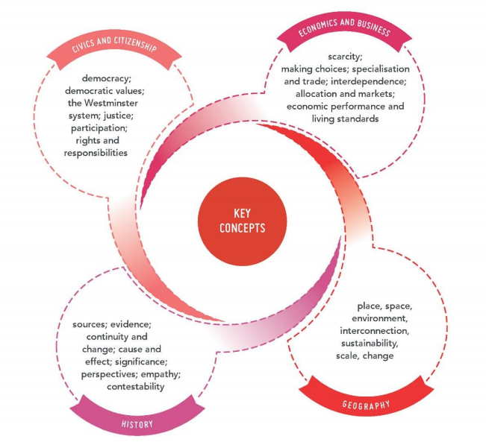

Slide 2

Learning Intentions
Success Criteria
To investigate the key concepts of Civics and Citizenship
I can …
Explain the term democracy
Identify two democratic values
Name the key components of Australia’s parliament
Describe the meaning of justice
Give examples of how young people can participate in society
Discuss the rights and responsibilities of Australian citizens
Notes:
Image sourced from https://callanmorse.wordpress.com/2015/03/06/week-two-blog-civics-citizenship/

Slide 3



1. Democracy
Watch the video and be ready to answer questions about the meaning of democracy and an individual’s democratic rights
1. Democracy
A system of government in which people choose their rulers by voting in elections.
Notes:
Democracy - A short introduction
https://youtu.be/u6jgWxkbR7A?t=179
3 mins
Supplementary video – What is democracy – Australian Human Right Commission
https://www.youtube.com/watch?v=8Eu6G5YrBt4&feature=emb_logo

Slide 4



2. Democratic values
They are the ideas or beliefs that make a society fair.
The Australian democracy has at its heart, the following core values:
Freedom of election and being elected- Democratic decision-making
Freedom of assembly and political participation
Freedom of speech, expression and religious belief
Equality before Law-Rule of law
Human rights and equality
Notes:
https://www.youtube.com/watch?v=DTT86MSn-pQ&feature=emb_logo
The Australian Way – 5.40 minutes

Slide 5

Activity Sheet - Connect the ‘value’ to its ‘definition’
2 mins
Australian Values |  | Definition
Respect |  | All people are treated fairly, or without in justice, and are given equal opportunity. Also known as a ‘fair go’ in Australia.
Equality |  | Rights and privileges for all, without discrimination based on gender, race, religion, age, sexual orientation or level of educations. All citizens have the right to same opportunities.
Fairness |  | Rights, privileges and responsibilities for all without interference, or control from other citizens or government.
Freedom |  | Treating others with consideration and valuing their view, beliefs and rights

Slide 6
Ready with your answers?
Australian Values |  | Definition
Respect |  | All people are treated fairly, or without in justice, and are given equal opportunity. Also known as a ‘fair go’ in Australia.
Equality |  | Rights and privileges for all, without discrimination based on gender, race, religion, age, sexual orientation or level of educations. All citizens have the right to same opportunities.
Fairness |  | Rights, privileges and responsibilities for all without interference, or control from other citizens or government.
Freedom |  | Treating others with consideration and valuing their view, beliefs and rights

Slide 7

What are our school values?
Responsibility
Respect
Tolerance

Slide 8
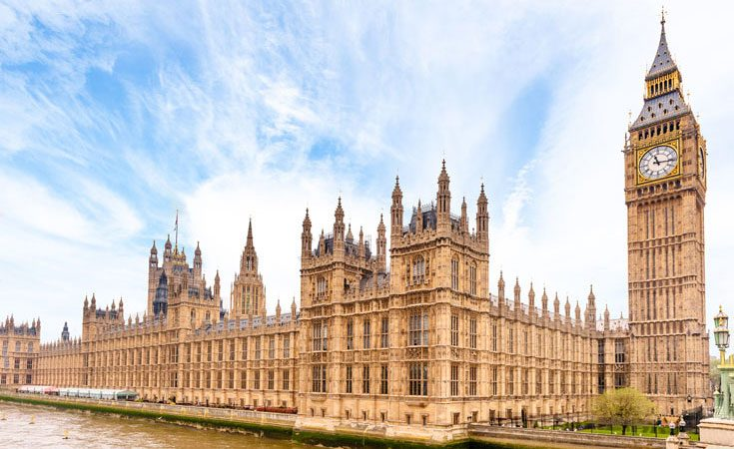
3. The Westminster System
A democratic system of government modelled from the United Kingdom (Palace of Westminster of British Parliament).
Features of the Westminster system:
Executive branch – made up of members of the legislature and Prime Minister
Opposition parties
Bicameral or Unicameral legislature
Ceremonial head of state (Queen Elizabeth II)
Notes:
https://education.abc.net.au/web/splash#!/media/2717810/the-westminster-system-and-borrowed-traditions
5 mins 28 secs
Annabel Crabb explains the interesting traditions that the Parliament of Australia has borrowed from the parliament of Westminster in the United Kingdom. Who is Black Rod, and what is a sergeant-at-arms? What is the Mace, and why is a hood placed over it when entering the presence of the Governor-General? And why would representatives of Australia's armed forces aim artillery at Parliament House?

Slide 9
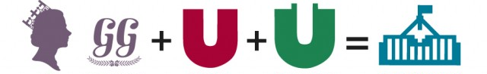
Activity Sheet – Fill in the blanks.
2 mins
Identify the components of the Westminster System in Australia:
Governor General
House of Representatives
Senate
Sovereign
Parliament
Notes:
To encourage students to recall the key words, the words used in this activity will only appear afer the teacher makes a mouse click.

Slide 10
Ready with your answers?
Identify the components of the Westminster System in Australia:
Governor General
House of Representatives
Senate
Sovereign
Parliament

Slide 11

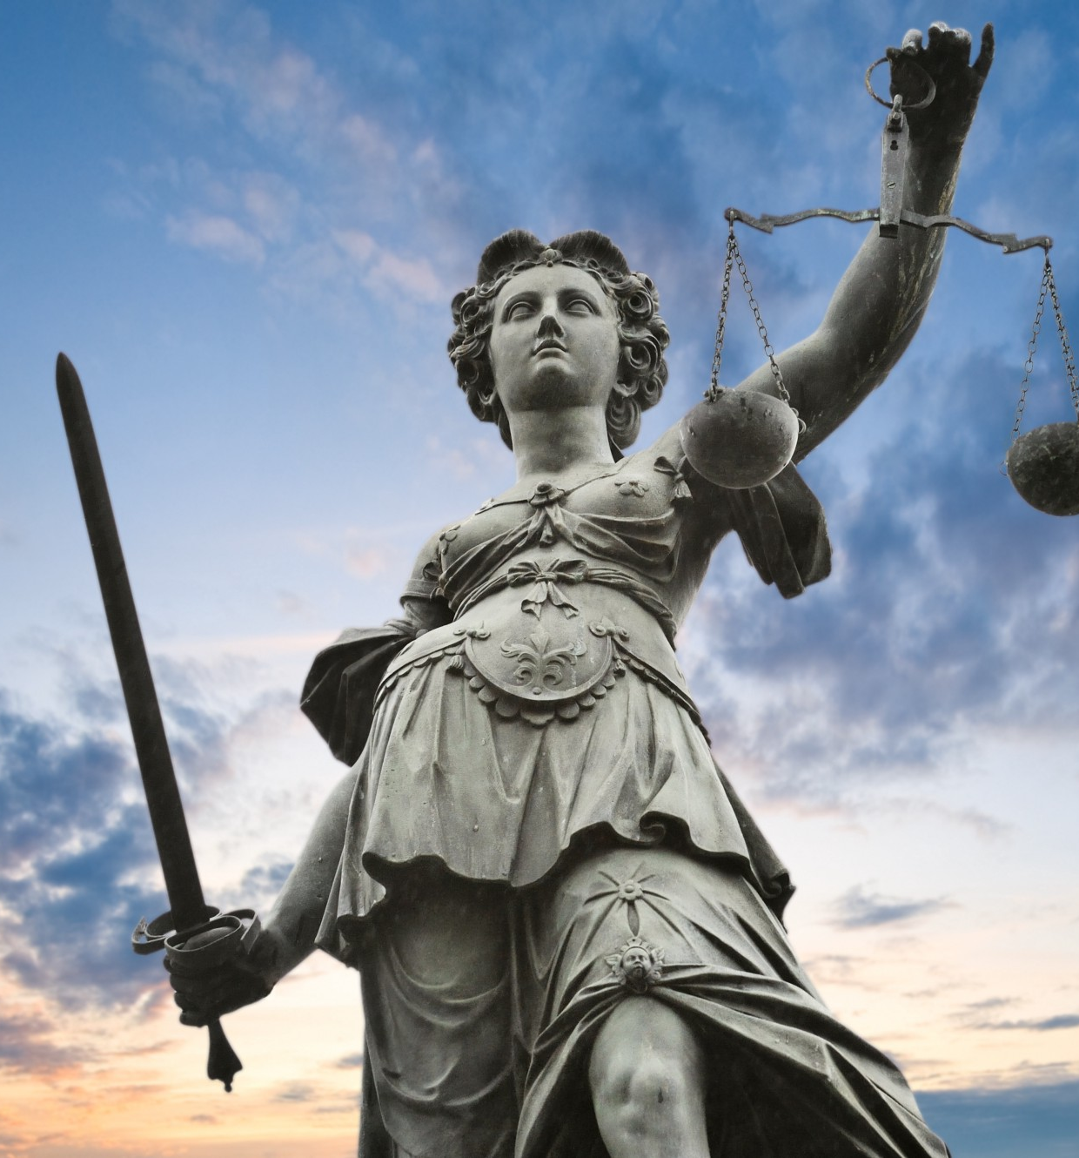
4. Justice
Fairness in the way people are treated.
Equality before the law
No one is above the law
Notes:
https://www.youtube.com/watch?v=H0CTHVCkm90
10.14 minutes
In today’s episode, Hank asks you to consider all the ways people talk about justice and what we really mean when we use that word. We’ll explain various theories of justice, just distribution, and different approaches to punishment.

Slide 12
Activity Sheet – Use these words to complete the paragraph.
2 mins
cultures
fairness
payback
societies
The idea of justice can mean different things to people from different __ __ __ __ __ __ __ __ __ and __ __ __ __ __ __ __ __ ; for some it might mean __ __ __ __ __ __ __ , while for others it might mean __ __ __ __ __ __ __ __ . However, the concept of justice in Australia ultimately means that people should treat each other in a way that is fair and balanced.

Slide 13
Ready with your answers?
cultures
fairness
payback
societies
The idea of justice can mean different things to people from different __ __ __ __ __ __ __ __ __ and __ __ __ __ __ __ __ __ ; for some it might mean __ __ __ __ __ __ __ , while for others it might mean __ __ __ __ __ __ __ __ . However, the concept of justice in Australia ultimately means that people should treat each other in a way that is fair and balanced.

Slide 14
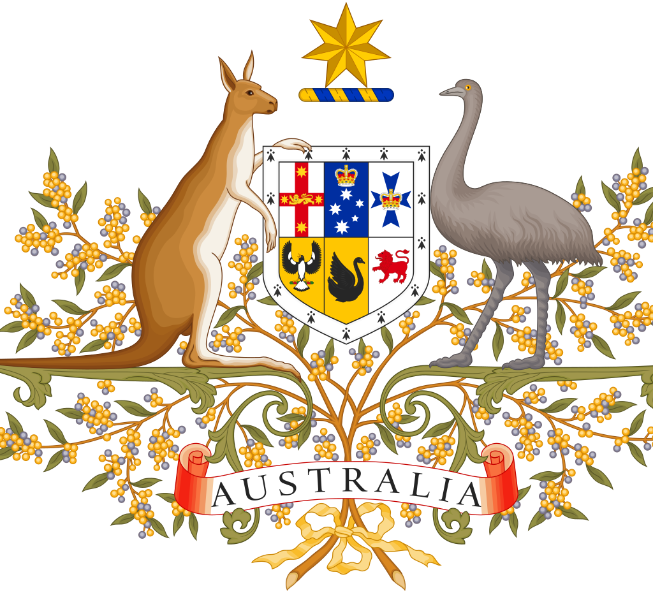
5. Participation
How an individual can be involved in the political and legal system.
As both a decision maker
As an agent of change
Notes:
For example, people can participate in the Australian government by voting.
Behind The News - Broadcast: Tue 24 May 2016, 10:00 am
4.36 minutes
http://www.abc.net.au/btn/story/s4464749.htm

Slide 15



Activity Sheet
5 mins
As you are not yet old enough to vote, think of some other ways can you participate in Australia’s democratic society?
Discuss your ideas with a neighbour
Get ready to share your discussions
Notes:
These slide steps the students through the process of a Think Pair Share.
Suggestions:
Volunteer with an NGO (non-government organisation) that supports your beliefs and values, volunteer on your shire Council’s YAC (Youth Advisory Council, join the youth arm of a political party (ie Young Liberals or Young Labor), go and see your local member of parliament, use lobby groups, sign petitions, protest …

Slide 16
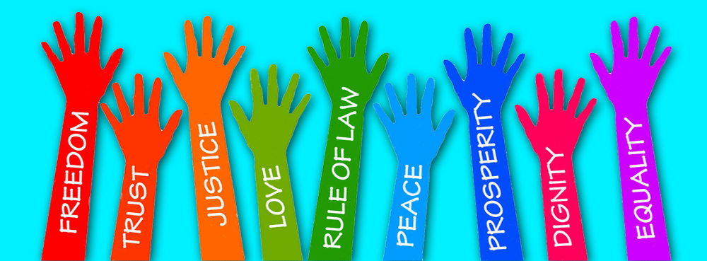
6. Rights and responsibilities
A right is a freedom that is protected, ie our human rights.
A responsibility is a duty of something you should do, for example voting.
Notes:
For example, human rights are basic entitlements that belong to every one of us.
The Australian Human Rights Commission - This animated video introduces viewers to children's rights.
https://www.youtube.com/watch?v=HHNfaPuoZHM&feature=emb_logo
2 minutes

Slide 17
Activity Sheet - Write in your responsibilities in the table
3 mins
Rights | Responsibilities
to elect representatives to the school’s student council
to education
to health services
vote in student councillor elections
attend school and participate in learning
take care of own health
Notes:
This task forms the basis of a teacher lead classroom discussion.

Slide 18
Success Criteria
I can …
Explain the term democracy
Identify two democratic values
Name the key components of Australia’s parliament
Describe the meaning of justice
Give examples of how young people can participate in society
Discuss the rights and responsibilities of Australian citizens
Notes:
Image sourced from https://callanmorse.wordpress.com/2015/03/06/week-two-blog-civics-citizenship/

